Slide 1
Data Science project
Sapir Naugauker & Ruth Israel
06/2021

Slide 2


CarMax
Who we are?
Company that buys used vehicles, repairs them and sells at an attractive price.
Was first open in September 1993, since then there is more than 220 stores.
On of the largest retailer of used car in USA.
The company website has detailed and specific information about each vehicle. Allows the buyer to find the right vehicle for him without having to go to the store.
2

Slide 3



How to choose a car?
Most people buy a used car according to the value of specific variables, such as year of manufacture, type of car, model, amount of miles, horsepower ....
The website give more information about the cars, that can give more indication of the vehicle and its value. Such as types of wheels, types of gears, seats, audio system, electric windows.
The addition of information can change the price of the car. The price of the vehicle can be higher or lower than its real price, depending on the additional features.
3

Slide 4
Main Steps
Comparing variables to the price and visualization for better understanding
Collecting the data from the site using URL
Understanding and delivering results and future model
Scrubbing Data
Linear Regression
1
2
3
4
5
Scrape the Data
Data Visualization
Interpreting Data
Cleaning, filtering and formatting the data
Creating an algorithm (linear regression) for prediction and modeling
4

Slide 5

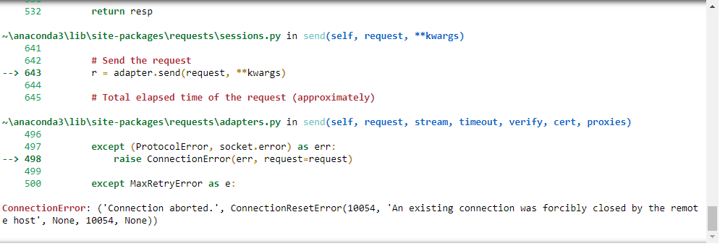
Scrape the Data
Send a request to check if we can get the data from the website.
But it return an ERROR. after a little internet search we found out that this is error 403 – Access is blocked and protected.
5

Slide 6

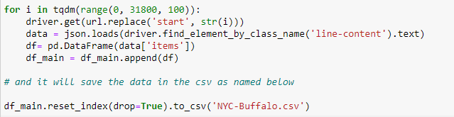
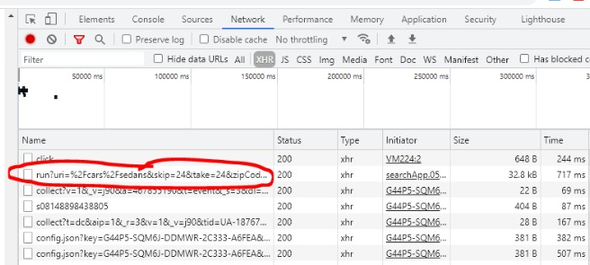
Scrape the Data
We start check the web and his HTML, when we saw that there was access to information for every click on the site (the file with the biggest size).
So we use this in our function for every page in the website.
The function call the URL in rang of 0-100 for all possible results of the page, because we did not know how many results there are in total, we set a maximum.
6

Slide 7
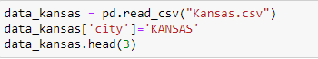
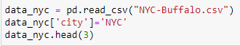
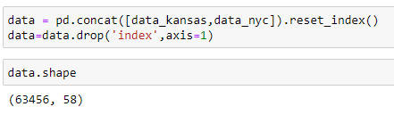
Scrape the Data
We ran the test for two countries, so we could see if the country also had an effect.
We saved the two information tables for the 2 countries, then merged them into one table containing over 60,000 rows and over 50 columns.
7

Slide 8
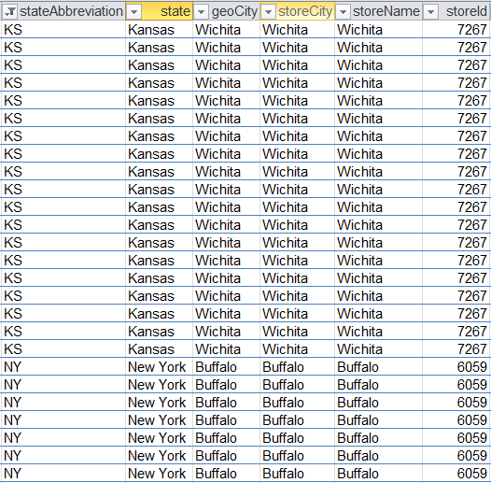
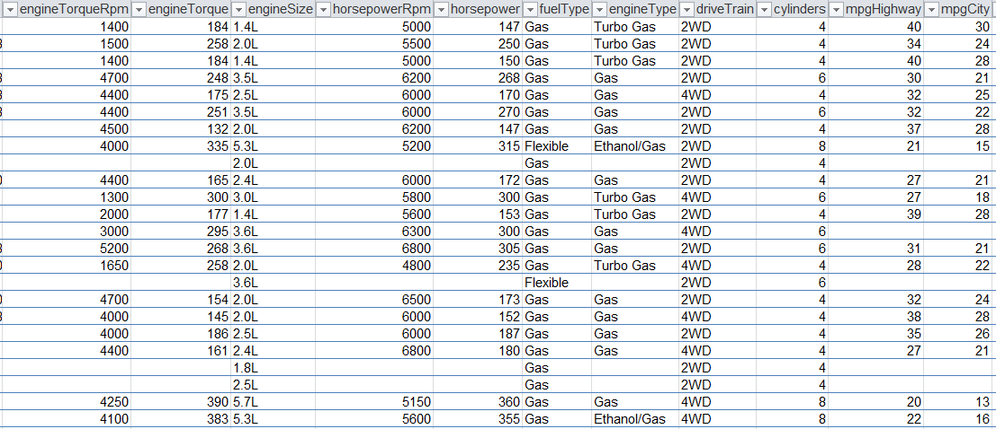
The Dataset
8

Slide 9

Scrubbing Data
We was check every column and row in the database. And make functions to deal with all the problems.
Dealing with duplicates info :
Check and drop the columns with the same information.
Deal with complement columns :
Comprehensive examination and merging of both into one column.
All cleaning :
Simplify information that is too complex and drops columns that didn’t give good info.
Dealing with missing values :
Dropping rows and columns with to many NAs, fill the category fields with common values and replace missing values ​​in numeric columns with average values.
9

Slide 10
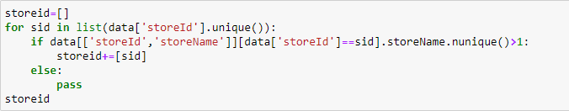
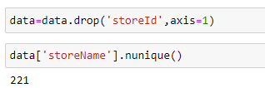
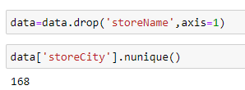
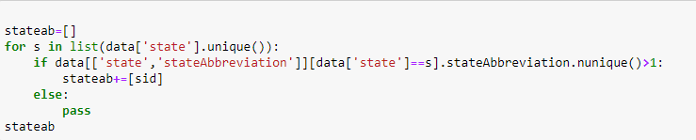
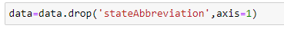
Dealing with duplicates info
At first glance we noticed that there are several columns that containing the same information, we checked them and reduced to one column.
10

Slide 11
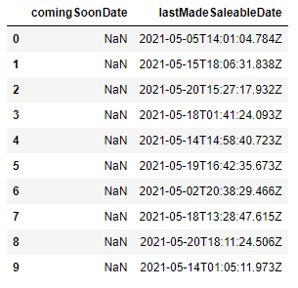
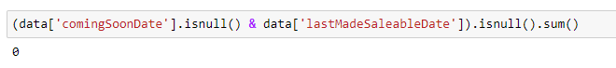
Deal with complement columns
We noticed that there are 2 variables that are close to each other in their meaning –
lastMadeSaleableDate is actually the date when the car was uploaded to the website for sale.
comingSoonDate is the date when the vehicle will be available for sale.
We checked that indeed at least one of the columns has information and there are no rows in which both columns have NA.
11

Slide 12
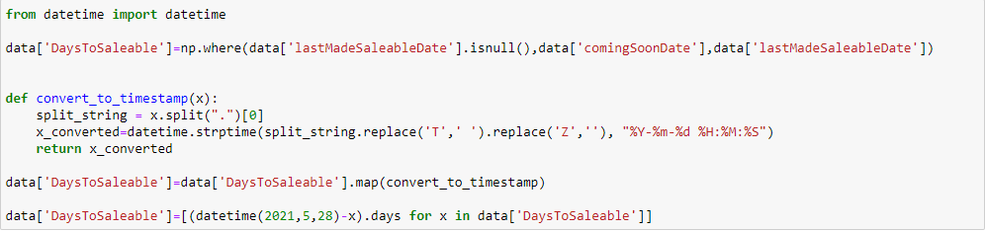
Deal with complement columns
The function runs on both columns and checks which of them has NA and which has information. She puts the information into a new column called DaysToSaleable
At the end, we deletes the two columns
12

Slide 13
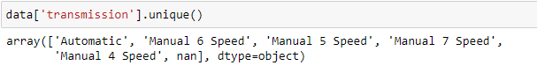
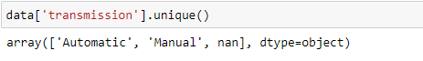
All cleaning
We have arranged the column of the Transition so that we can identify between the types of gearbox (automatic or manual).
Information that we didn’t need or not good enough.
13

Slide 14
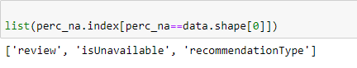
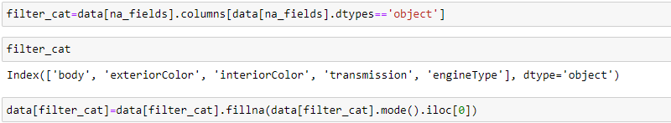
Dealing with missing values
Check the columns with 100% NA and drop them.
For category fields
Fill the missing sells
For Numeric fields
14

Slide 15
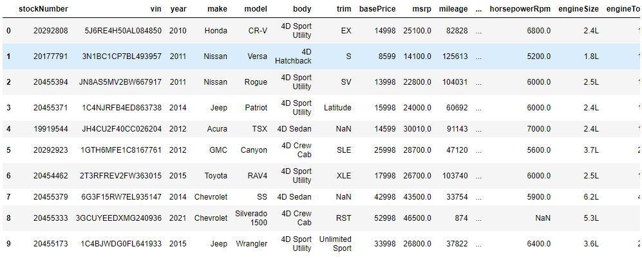
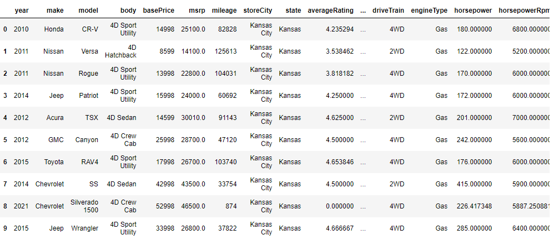
Before
Rows - 63,456
Columns - 58
After
Rows - 63,456
Columns - 35
15

Slide 16
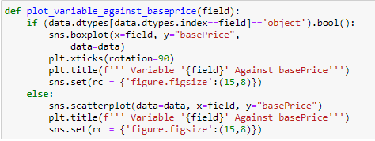

Data Visualization
We went through all the columns in the dataset and compared to the price offered by the company.
We presented the numerical variables using scatterplot and the categorical variables we presented using boxplot.
Variables we saw that did not affect (like the state), we removed from the database.
16

Slide 17
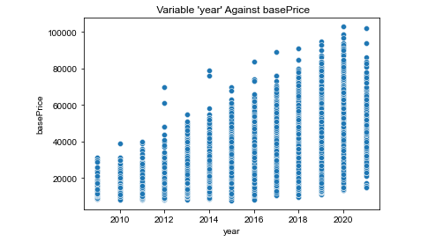
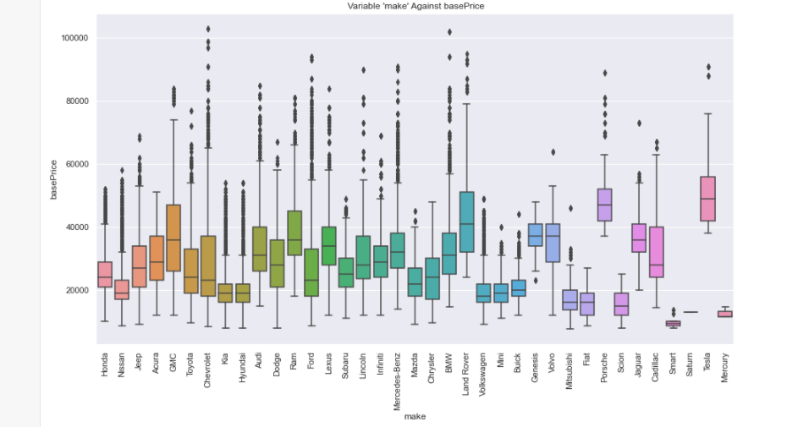
Data Visualization
As expected, the year and company of the vehicle has an impact on the price
17

Slide 18
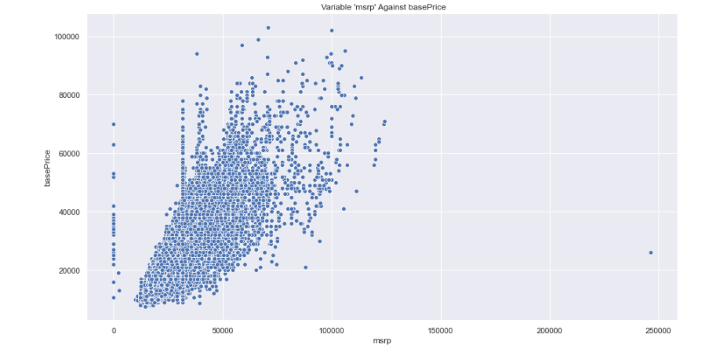
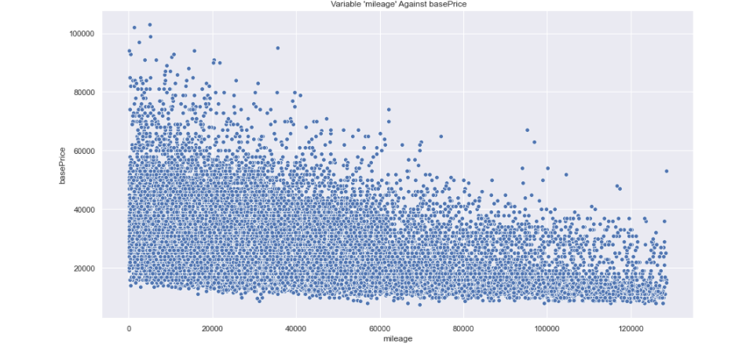
Data Visualization
As we all know, the price that the company give to the vehicle is bigger and effect from the value that the manufacturer's suggested
The KM that the vehicle has done is effect the price.
18

Slide 19
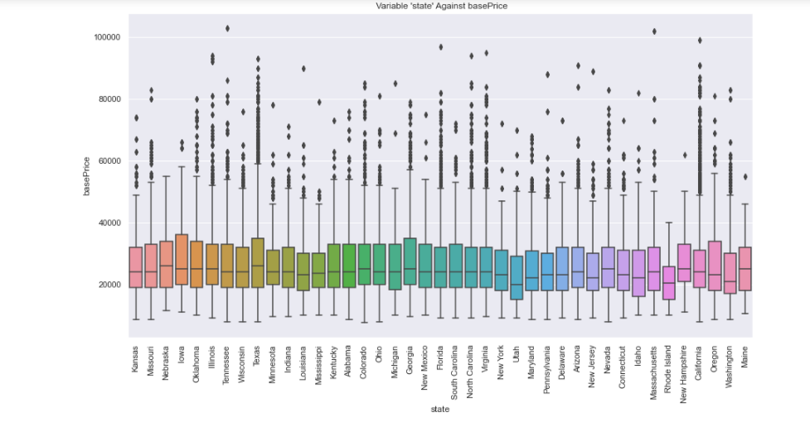
Data Visualization
We thought that the country in which the vehicle was sold would have an effect on the price.
According to the graph it can be seen that there is not so we decided to lower the variable.
19

Slide 20
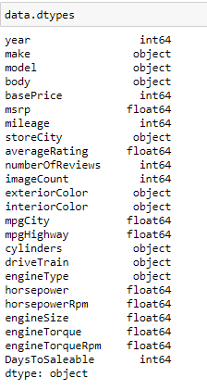
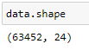
The Dataset
After all the cleaning and dropping cells, we were left with a dataset that contains only cells that can affect the price
20

Slide 21
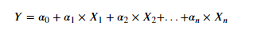
Multiple Linear Regression
What is linear regression?
mathematical method for finding the parameters of the relationship between an independent variable X and a dependent variable Y, assuming that the relationship between them is linear. The method is used to analyze statistical samples.
The linear regression formula calculates the straight line passing through the points in the sample. In precise direct contact mode all points in the sample will be on the line itself. In reality additional factors affect the sample and the dots are usually scattered around the line. Multiple linear regression calculates a relationship between several independent variables together, and one dependent variable.
21

Slide 22
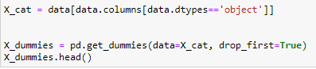
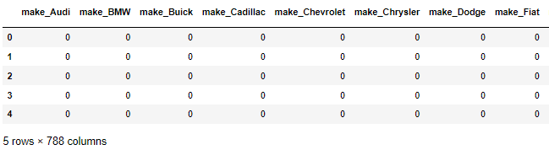
Dummify The Categorical Variables
We convert all category data to dummy variables. In this way we turn the subcategories of each variable into a column and represent in 1 when the subcategory exists and in 0 when it does not.
22

Slide 23
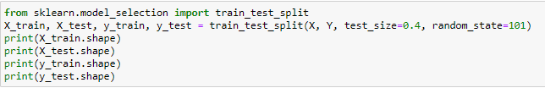
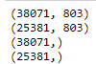
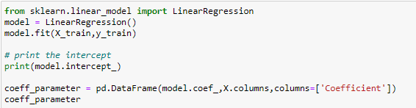
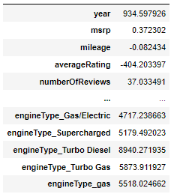
Run the Multiple Linear Regression
Divide the dataset into 40% test and 60% for training
23

Slide 24
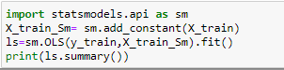
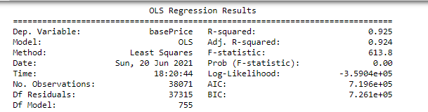
Interpreting Data
The R-squared and Adj. R-squared they tell you what's the level of fitting of the model.
Fitting of 100% means that you predict the basePrice without any error. Fitting of 0% means that you don't predict anything well.
Adj. R-squared is like R-squared where the total number of variables is taken into account.
24

Slide 25
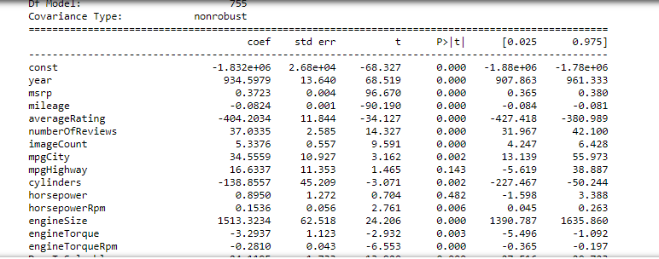
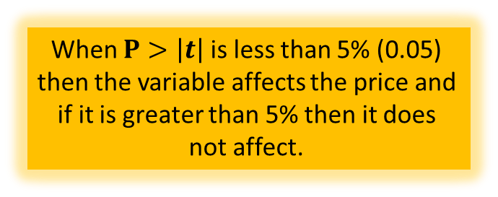
When $P>\left|t\right|$ is less than 5% (0.05) then the variable affects the price and if it is greater than 5% then it does not affect.
25

Slide 26


How Could we take this forward?
we sought on the web on found that there are methods to choose the optimal sets of variable. (stepwise regression)
Random Forest this model runs several sub models with a small number of variables on a random subset of datapoints. The performances are evaluated by averaging all the sub performances.
maybe among the variables that we inputted in the model, some could be transformed in order to improve the performances of the our predictions? (feature engineering)
26

